Slide 1
Micro services Design Pattern

Slide 2
Microservices
An architectural style that structures an application as a collection of small autonomous services, modeled around a business domain.
In a Microservice Architecture, each service is self-contained and implements a single business capability.

Slide 3
Principles Used to Design Microservice Architecture
The principles used to design Microservices are as follows:
Independent & Autonomous Services
Scalability
Decentralization
Resilient Services
Real-Time Load Balancing
Availability
Continuous delivery through DevOps Integration
Seamless API Integration and Continuous Monitoring
Isolation from Failures
Auto -Provisioning

Slide 4
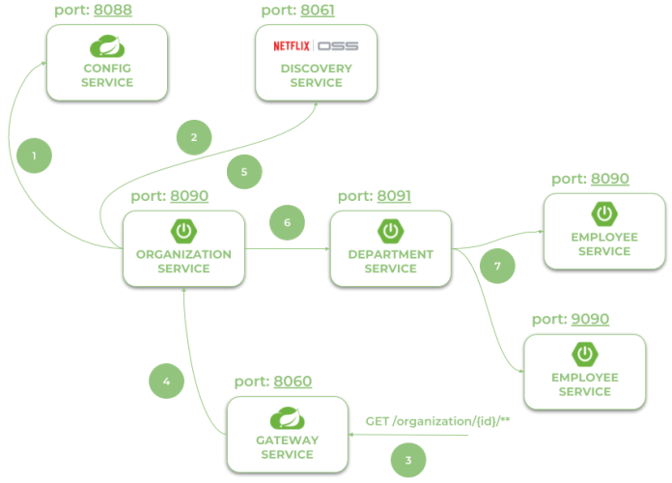
MicroServices with Spring Cloud Example
Architecture of microservices-based system
Notes:
Using Spring Boot 3 in cloud-native development
Provide service discovery for all microservices with Spring Cloud Netflix Eureka. Anticipating your questions – yes, Eureka is still there. It’s the last of Netflix microservices components still available in Spring Cloud
Spring Cloud OpenFeign in inter-service communication
Distributed configuration with Spring Cloud Config
API Gateway pattern with Spring Cloud Gateway including a global OpenAPI documentation with the Springdoc project
Collecting traces with Micrometer OpenTelemetry and Zipkin
http://localhost:8060/employee/
http://localhost:8060/department/organization/1
http://localhost:8060/department/organization/1/with-employees
http://localhost:8060/organization/
http://localhost:8060/organization/1/with-departments
http://localhost:8060/swagger-ui.html

Slide 5
MicroServices with Spring Cloud Example
Architecture of microservices-based system consists of the following modules:
gateway-service - a module that Spring Cloud Netflix Zuul for running Spring Boot application that acts as a proxy/gateway in our architecture.
config-service - a module that uses Spring Cloud Config Server for running configuration server in the native mode. The configuration files are placed on the classpath.
discovery-service - a module that depending on the example it uses Spring Cloud Netflix Eureka or Spring Cloud Netflix Alibaba Nacos as an embedded discovery server.
employee-service - a module containing the first of our sample microservices that allows to perform CRUD operation on in-memory repository of employees
department-service - a module containing the second of our sample microservices that allows to perform CRUD operation on in-memory repository of departments. It communicates with employee-service.
organization-service - a module containing the third of our sample microservices that allows to perform CRUD operation on in-memory repository of organizations. It communicates with both employee-service and organization-service.
Notes:
http://localhost:8060/employee/
http://localhost:8060/department/organization/1
http://localhost:8060/department/organization/1/with-employees
http://localhost:8060/organization/
http://localhost:8060/organization/1/with-departments
http://localhost:8060/swagger-ui.html

Slide 6
Design Patterns of Microservices
Decomposition Patterns
Integrator Patterns
Database Patterns
Observability Patterns
Cross-Cutting Concern Patterns

Slide 7
Decomposition Patterns
Decompose by Business Capability
Problem
Microservices is all about making services loosely coupled, applying the single responsibility principle. However, breaking an application into smaller pieces has to be done logically. How do we decompose an application into small services?
Solution
One strategy is to decompose by business capability. A business capability is something that a business does in order to generate value. The set of capabilities for a given business depend on the type of business. For example, the capabilities of an insurance company typically include sales, marketing, underwriting, claims processing, billing, compliance, etc. Each business capability can be thought of as a service, except it’s business-oriented rather than technical.

Slide 8
Decomposition Patterns
Decompose by Subdomain
Problem
Decomposing an application using business capabilities might be a good start, but you will come across so-called "God Classes" which will not be easy to decompose. These classes will be common among multiple services. For example, the Order class will be used in Order Management, Order Taking, Order Delivery, etc. How do we decompose them?
Solution
For the "God Classes" issue, DDD (Domain-Driven Design) comes to the rescue. It uses subdomains and bounded context concepts to solve this problem. DDD breaks the whole domain model created for the enterprise into subdomains. Each subdomain will have a model, and the scope of that model will be called the bounded context. Each microservice will be developed around the bounded context.
Note: Identifying subdomains is not an easy task. It requires an understanding of the business. Like business capabilities, subdomains are identified by analyzing the business and its organizational structure and identifying the different areas of expertise.

Slide 9
Strangler Pattern
Problem
So far, the design patterns we talked about were decomposing applications for greenfield, but 80% of the work we do is with brownfield applications, which are big, monolithic applications. Applying all the above design patterns to them will be difficult because breaking them into smaller pieces at the same time it's being used live is a big task.
Solution
The Strangler pattern comes to the rescue. The Strangler pattern is based on an analogy to a vine that strangles a tree that it’s wrapped around. This solution works well with web applications, where a call goes back and forth, and for each URI call, a service can be broken into different domains and hosted as separate services. The idea is to do it one domain at a time. This creates two separate applications that live side by side in the same URI space. Eventually, the newly refactored application “strangles” or replaces the original application until finally you can shut off the monolithic application.

Slide 10
Integrator Pattern
API Gateway Pattern
Aggregator Pattern
Client-Side UI Composition Pattern

Slide 11
API Gateway Pattern
Problem
When an application is broken down to smaller microservices, there are a few concerns that need to be addressed:
How to call multiple microservices abstracting producer information.
On different channels (like desktop, mobile, and tablets), apps need different data to respond for the same backend service, as the UI might be different.
Different consumers might need a different format of the responses from reusable microservices. Who will do the data transformation or field manipulation?
How to handle different type of Protocols some of which might not be supported by producer microservice.
Solution
An API Gateway helps to address many concerns raised by microservice implementation, not limited to the ones above.
An API Gateway is the single point of entry for any microservice call.
It can work as a proxy service to route a request to the concerned microservice, abstracting the producer details.
It can fan out a request to multiple services and aggregate the results to send back to the consumer.
One-size-fits-all APIs cannot solve all the consumer's requirements; this solution can create a fine-grained API for each specific type of client.
It can also convert the protocol request (e.g. AMQP) to another protocol (e.g. HTTP) and vice versa so that the producer and consumer can handle it.
It can also offload the authentication/authorization responsibility of the microservice.

Slide 12
Aggregator Pattern
Problem
We have talked about resolving the aggregating data problem in the API Gateway Pattern. However, we will talk about it here holistically. When breaking the business functionality into several smaller logical pieces of code, it becomes necessary to think about how to collaborate the data returned by each service. This responsibility cannot be left with the consumer, as then it might need to understand the internal implementation of the producer application.
Solution
The Aggregator pattern helps to address this. It talks about how we can aggregate the data from different services and then send the final response to the consumer. This can be done in two ways:
1. A composite microservice will make calls to all the required microservices, consolidate the data, and transform the data before sending back.
2. An API Gateway can also partition the request to multiple microservices and aggregate the data before sending it to the consumer.
It is recommended if any business logic is to be applied, then choose a composite microservice. Otherwise, the API Gateway is the established solution.

Slide 13
Aggregator Pattern
The Aggregator design pattern in Microservice architecture is a design pattern used to compose a complex service by aggregating the responses of multiple independent microservices.
It's also one of the essential Microservices Design patterns along with SAGA, CQRS, and Event Sourcing.
This pattern is proper when a client request requires data or functionality distributed across multiple microservices.
It can improve the performance and scalability of the system by allowing each microservice to focus on a specific task and reducing the workload of a single microservice.
We are going to discuss how the Aggregator Microservice Pattern can be implemented in Java using various approaches, such as asynchronous communication, synchronous communication, or a combination of both.

Slide 14
Aggregator Pattern Example
In Java, the Aggregator Microservice Pattern can be implemented using various approaches, such as
Asynchronous communication
Synchronous communication
Combination of both

Slide 15
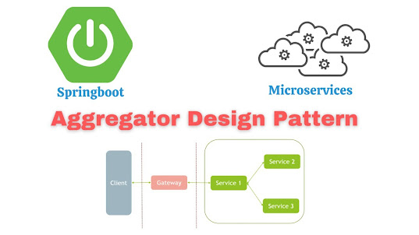
Aggregator Pattern Example-Asynchronous communication
One way to implement the Aggregator Microservice Pattern in Java is by using asynchronous communication between the microservices. In this approach, the client sends a request to the aggregator microservice, which then sends requests to the individual microservices in parallel.
Each microservice processes the request and sends the response back to the aggregator microservice, which then aggregates the responses and returns the result to the client.
This approach has the advantage of improving the performance of the system by allowing the microservices to process the requests concurrently. However, it requires the use of an asynchronous communication mechanism, such as message queues or event-driven architectures, which can introduce additional complexity to the system.

Slide 16
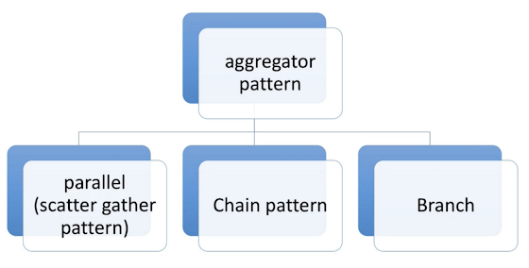
Aggregator Pattern Example-Asynchronous communication
In this example, the AsyncAggregatorMicroservice class uses the CompletableFuture class from the Java Concurrency API to send requests to the individual microservices asynchronously.
The CompletableFuture.allOf() method is used to wait for all the responses to be received, and the thenApply() method is used to aggregate the responses and return the result to the client.
public class AsyncAggregatorMicroservice {
private final ExecutorService executorService;
private final Microservice1Client microservice1Client;
private final Microservice2Client microservice2Client;
private final Microservice3Client microservice3Client;
public AsyncAggregatorMicroservice(ExecutorService executorService, Microservice1Client microservice1Client, Microservice2Client microservice2Client, Microservice3Client microservice3Client) {
this.executorService = executorService;
this.microservice1Client = microservice1Client;
this.microservice2Client = microservice2Client;
this.microservice3Client = microservice3Client;
}
public CompletableFuture<AggregatedResponse> processRequest(Request request) {
CompletableFuture<Response1> response1Future
= CompletableFuture.supplyAsync(()
-> microservice1Client.processRequest(request), executorService);
CompletableFuture<Response2> response2Future
= CompletableFuture.supplyAsync(()
-> microservice2Client.processRequest(request), executorService);
CompletableFuture<Response3> response3Future
= CompletableFuture.supplyAsync(()
-> microservice3Client.processRequest(request), executorService);
return CompletableFuture.allOf(response1Future, response2Future, response3Future)
.thenApply(v ->
new AggregatedResponse(response1Future.join(), response2Future.join(),
response3Future.join()));
}
}

Slide 17
Aggregator Pattern Example-Synchronous Communication
Another way to implement the Aggregator Microservice Pattern in Java is by using synchronous communication between the microservices.
In this approach, the client sends a request to the aggregator microservice, which then sends requests to the individual microservices sequentially.
Each microservice processes the request and sends the response back to the aggregator microservice, which then aggregates the responses and returns the result to the client.
This approach has the advantage of simplicity, as it does not require the use of asynchronous communication mechanisms.
However, it can have a negative impact on the performance of the system, as the aggregator microservice has to wait for each microservice to complete its task before moving on to the next one.

Slide 18
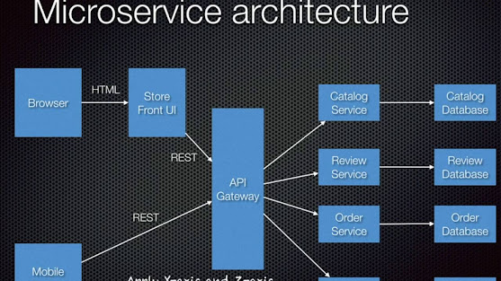
Aggregator Pattern Example-Synchronous communication
In this example, the SyncAggregatorMicroservice class sends requests to the individual microservices synchronously, one after the other.
The responses are then aggregated and returned to the client.
public class SyncAggregatorMicroservice {
private final Microservice1Client microservice1Client;
private final Microservice2Client microservice2Client;
private final Microservice3Client microservice3Client;
public SyncAggregatorMicroservice(Microservice1Client microservice1Client, Microservice2Client microservice2Client,
Microservice3Client microservice3Client) {
this.microservice1Client = microservice1Client;
this.microservice2Client = microservice2Client;
this.microservice3Client = microservice3Client;
}
public AggregatedResponse processRequest(Request request) {
Response1 response1 = microservice1Client.processRequest(request);
Response2 response2 = microservice2Client.processRequest(request);
Response3 response3 = microservice3Client.processRequest(request);
return new AggregatedResponse(response1, response2, response3);
}
}

Slide 19
Aggregator Pattern Example- Combination of Asynchronous and Synchronous Communication
It is also possible to implement the Aggregator Microservice Pattern in Java by combining asynchronous and synchronous communication.
In this approach, the client sends a request to the aggregator microservice, which then sends requests to some of the microservices asynchronously and to others synchronously, depending on the requirements of the system.
This approach allows for a balance between performance and simplicity, as it allows the microservices to process the requests concurrently where possible, while still keeping the implementation straightforward.

Slide 20
Aggregator Pattern Example- Combination of Asynchronous and Synchronous Communication
An example of an Aggregator Microservice that uses a combination of asynchronous and synchronous communication in Java:
import java.util.concurrent.CompletableFuture;
import java.util.concurrent.ExecutorService;
public class HybridAggregatorMicroservice {
private final ExecutorService executorService;
private final Microservice1Client microservice1Client;
private final Microservice2Client microservice2Client;
private final Microservice3Client microservice3Client;
public HybridAggregatorMicroservice(ExecutorService executorService, Microservice1Client microservice1Client,
Microservice2Client microservice2Client, Microservice3Client microservice3Client) {
this.executorService = executorService;
this.microservice1Client = microservice1Client;
this.microservice2Client = microservice2Client;
this.microservice3Client = microservice3Client;
}
public AggregatedResponse processRequest(Request request) {
CompletableFuture<Response1> response1Future = CompletableFuture
.supplyAsync(() -> microservice1Client.processRequest(request), executorService);
Response2 response2 = microservice2Client.processRequest(request);
CompletableFuture<Response3> response3Future = CompletableFuture
.supplyAsync(() -> microservice3Client.processRequest(request), executorService);
return CompletableFuture.allOf(response1Future, response3Future)
.thenApply(v -> new AggregatedResponse(response1Future.join(), response2, response3Future.join()));
}
}
Notes:
In this example, the `HybridAggregatorMicroservice` class sends requests to the `microservice1Client` and `microservice3Client` asynchronously, and to the `microservice2Client` synchronously. The responses are then aggregated and returned to the client.
The Aggregator Microservice Pattern in Java is a useful design pattern for composing complex services by aggregating the responses of multiple independent microservices. In Java, this pattern can be implemented using asynchronous communication, synchronous communication, or a combination of both, depending on the requirements of the system.
Asynchronous communication can improve the performance of the system, but it requires the use of additional communication mechanisms. Synchronous communication is simpler to implement, but it can have a negative impact on performance.
A combination of asynchronous and synchronous communication allows for a balance between performance and simplicity.
Read more: https://www.java67.com/2023/01/aggregator-microservice-pattern-in-java.html#ixzz8KQqKEgep Read more: https://www.java67.com/2023/01/aggregator-microservice-pattern-in-java.html#ixzz8KQqEnaDk

Slide 21
Client-Side UI Composition Pattern
Problem
When services are developed by decomposing business capabilities/subdomains, the services responsible for user experience have to pull data from several microservices. In the monolithic world, there used to be only one call from the UI to a backend service to retrieve all data and refresh/submit the UI page. However, now it won't be the same. We need to understand how to do it.
Solution
With microservices, the UI has to be designed as a skeleton with multiple sections/regions of the screen/page. Each section will make a call to an individual backend microservice to pull the data. That is called composing UI components specific to service. Frameworks like AngularJS and ReactJS help to do that easily. These screens are known as Single Page Applications (SPA). This enables the app to refresh a particular region of the screen instead of the whole page.

Slide 22
Database Pattern
Database per Service
Shared Database per Service
Command Query Responsibility Segregation (CQRS)
Saga Pattern

Slide 23
Database per Service
Problem
There is a problem of how to define database architecture for microservices. Following are the concerns to be addressed:
1. Services must be loosely coupled. They can be developed, deployed, and scaled independently.
2. Business transactions may enforce invariants that span multiple services.
3. Some business transactions need to query data that is owned by multiple services.
4. Databases must sometimes be replicated and sharded in order to scale.
5. Different services have different data storage requirements.
Solution
To solve the above concerns, one database per microservice must be designed; it must be private to that service only. It should be accessed by the microservice API only. It cannot be accessed by other services directly. For example, for relational databases, we can use private-tables-per-service, schema-per-service, or database-server-per-service. Each microservice should have a separate database id so that separate access can be given to put up a barrier and prevent it from using other service tables.

Slide 24
Shared Database per Service
Problem
We have talked about one database per service being ideal for microservices, but that is possible when the application is greenfield and to be developed with DDD. But if the application is a monolith and trying to break into microservices, denormalization is not that easy. What is the suitable architecture in that case?
Solution
A shared database per service is not ideal, but that is the working solution for the above scenario. Most people consider this an anti-pattern for microservices, but for brownfield applications, this is a good start to break the application into smaller logical pieces. This should not be applied for greenfield applications. In this pattern, one database can be aligned with more than one microservice, but it has to be restricted to 2-3 maximum, otherwise scaling, autonomy, and independence will be challenging to execute.

Slide 25
Command Query Responsibility Segregation (CQRS)
Problem
Once we implement database-per-service, there is a requirement to query, which requires joint data from multiple services — it's not possible. Then, how do we implement queries in microservice architecture?
Solution
CQRS suggests splitting the application into two parts — the command side and the query side. The command side handles the Create, Update, and Delete requests. The query side handles the query part by using the materialized views. The event sourcing pattern is generally used along with it to create events for any data change. Materialized views are kept updated by subscribing to the stream of events.

Slide 26
CQRS Pattern With Spring Boot
CQRS Pattern with Spring Boot which is one of the Microservice Design Patterns to independently scale read and write workloads of an application & have well optimized data schema.
Read vs Write Models
Most of the applications are CRUD in nature.
When we design these applications, we create entity classes and corresponding repository classes for CRUD operations.
We use the same model classes for all the CRUD operations.
However these applications might have completely different READ and WRITE requirements!
For example: Let’s consider an application in which we have 3 tables as shown here.
user
product
purchase_order
All these tables have been normalized. Creating a new user or a product or an order go to the appropriate tables quickly and directly.
But if we consider READ requirements, we would not simply want all the users, products, just orders.
Instead we would be interested in knowing all the orders details of an user, state wise total sale, state and product wise sale etc.
A lot of aggregate information which involves multiple tables join. All these join READ operations might require corresponding DTO mapping as well.

Slide 27
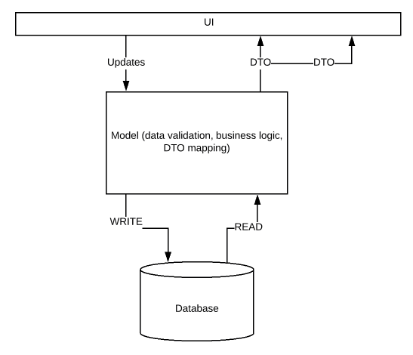
CQRS Pattern With Spring Boot
Notes:
More normalization we do, it is more easier to write and but it is more difficult to read which in turn affects the overall read performance.
Even though we say WRITE is easy, before we insert the record into the database, we might do business validation. All these logic might be present in the model class. So we might end up creating a very complex model which is trying to support both READ and WRITE.
An application can have completely different READ and WRITE requirements. So a model created for WRITE might not work for READ. To solve this problem, we can have separate models for READ and WRITE.

Slide 28
CQRS Pattern With Spring Boot
Read vs Write Traffic
Most of the web based applications are read heavy.
Let’s take Facebook/Twitter for example. Whether we post any new updates or not, we all check these applications very often in a day.
Of course, we keep getting updates in those applications which are due to some inserts in the DB. But it is a lot of READ than WRITE. Also, consider a flight-booking application.
Probably less than 5% of the users might book a ticket while majority of the application users would keep searching for the best flight meeting their needs.
Applications have more requests for READ operations compared to WRITE operations. To solve this problem, We can even have separate Microservices for READ and WRITE. So that they can be scaled in/out independently depends on their needs.
This is what CQRS Pattern is about which stands for Command Query Responsibility Segregation Pattern.
Command: modifies the data and does not return anything (WRITE)
Query: does not modify but returns data (READ)
That is separating Command (write) and Query (read) models of an application to scale read and write operations of an application independently. We can solve above 2 problems using CQRS Pattern.

Slide 29
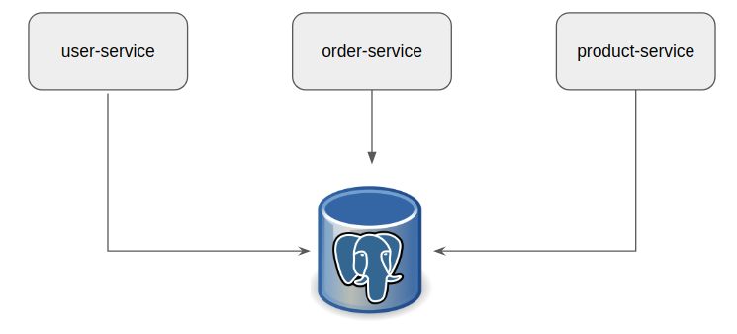
CQRS Pattern With Spring Boot
Implementation:
Lets consider a simple application in which we have 3 services as shown below. (Ideally all these services should have different databases. Here just for this demo, I am using same db). We are interested only in the order-service related functionalities for now for this demo.
We have 3 tables for this application as shown here.
user
product
purchase_order
Notes:
CREATE TABLE users( id serial PRIMARY KEY, firstname VARCHAR (50), lastname VARCHAR (50), state VARCHAR(10) );
CREATE TABLE product( id serial PRIMARY KEY, description VARCHAR (500), price numeric (10,2) NOT NULL );
CREATE TABLE purchase_order( id serial PRIMARY KEY, user_id integer references users (id), product_id integer references product (id), order_date date );

Slide 30
CQRS Pattern With Spring Boot
CREATE TABLE users( id serial PRIMARY KEY, firstname VARCHAR (50), lastname VARCHAR (50), state VARCHAR(10) );
CREATE TABLE product( id serial PRIMARY KEY, description VARCHAR (500), price numeric (10,2) NOT NULL );
CREATE TABLE purchase_order( id serial PRIMARY KEY, user_id integer references users (id), product_id integer references product (id), order_date date );
Lets assume that we have an interface for the order service for the read and write operations as shown below.
public interface OrderService {
void placeOrder(int userIndex, int productIndex);
void cancelOrder(long orderId);
List<PurchaseOrderSummaryDto> getSaleSummaryGroupByState();
PurchaseOrderSummaryDto getSaleSummaryByState(String state);
double getTotalSale();
}
It has multiple responsibilities like placing the order, cancelling the order and querying the table which produces different types of results.
Cancelling the order might involve additional business logic like order date should be within 30 days and partial refund calculation etc.
Notes:
CREATE TABLE users( id serial PRIMARY KEY, firstname VARCHAR (50), lastname VARCHAR (50), state VARCHAR(10) );
CREATE TABLE product( id serial PRIMARY KEY, description VARCHAR (500), price numeric (10,2) NOT NULL );
CREATE TABLE purchase_order( id serial PRIMARY KEY, user_id integer references users (id), product_id integer references product (id), order_date date );

Slide 31
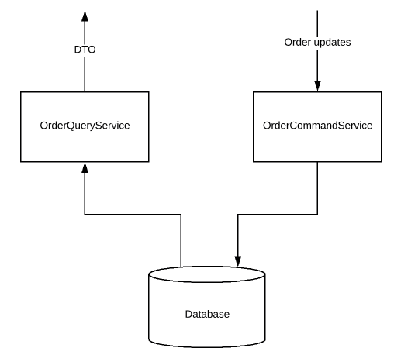
CQRS Pattern With Spring Boot
CQRS Pattern – Read & Write Interfaces:
Instead of having 1 single interface which is responsible for all the READ and WRITE operations, Lets split them into 2 different interfaces as shown here.
Query Service handles all the READ requirements
Command Service handles all other requirements which modifies the data
Order Query Service:
public interface OrderQueryService {
List<PurchaseOrderSummaryDto> getSaleSummaryGroupByState();
PurchaseOrderSummaryDto getSaleSummaryByState(String state);
double getTotalSale();
}
Order Command Service:
public interface OrderCommandService {
void createOrder(int userIndex, int productIndex);
void cancelOrder(long orderId);
}

Slide 32
CQRS Pattern With Spring Boot
CQRS Pattern – Read & Write Implementations:
Once we have separated command and query interfaces, Lets implement the operations.
Order Command Service
This is simple insert into the purchase_order table with its business logic which modifies the data – it does not return anything.
Order Query Service
@Service
public class OrderQueryServiceImpl implements OrderQueryService {
@Autowired
private PurchaseOrderSummaryRepository purchaseOrderSummaryRepository;
@Override
public List<PurchaseOrderSummaryDto> getSaleSummaryGroupByState() {
return this.purchaseOrderSummaryRepository.findAll()
.stream()
.map(this::entityToDto)
.collect(Collectors.toList());
}
@Override
public PurchaseOrderSummaryDto getSaleSummaryByState(String state) {
return this.purchaseOrderSummaryRepository.findByState(state)
.map(this::entityToDto)
.orElseGet(() -> new PurchaseOrderSummaryDto(state, 0));
}
@Override
public double getTotalSale() {
return this.purchaseOrderSummaryRepository.findAll()
.stream()
.mapToDouble(PurchaseOrderSummary::getTotalSale)
.sum();
}
private PurchaseOrderSummaryDto entityToDto(PurchaseOrderSummary purchaseOrderSummary){
PurchaseOrderSummaryDto dto = new PurchaseOrderSummaryDto();
dto.setState(purchaseOrderSummary.getState());
dto.setTotalSale(purchaseOrderSummary.getTotalSale());
return dto;
}
}

Slide 33
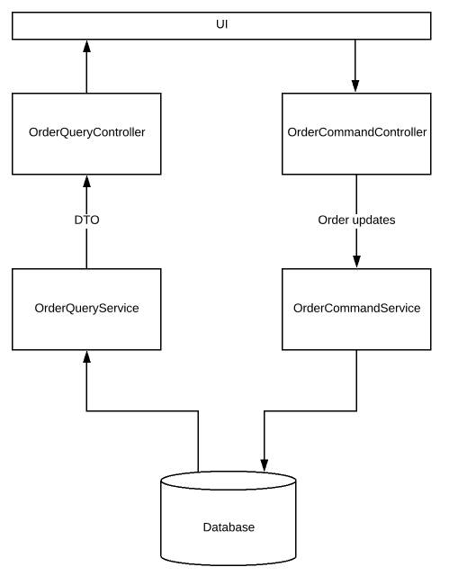
CQRS Pattern With Spring Boot
Command vs Query – Controllers:
Overall the project structure looks like this.
If you take a closer look at this, You could notice that I have 2 different controllers for Order Service.
See Project Structure
We have dedicated controllers for Query (READ) and
Command (WRITE).
We can even control if the app should work in
READ mode or WRITE mode based on a property value.

Slide 34
CQRS Pattern With Spring Boot
CQRS Pattern – Scaling:
Now we have successfully split the READ and WRITE models.
Now we need the ability to scale our system independently. Lets see how we can achieve that.
Creating Spring Bean At Run Time:
On the Query and Command controllers, I have added a condition for Spring Boot whether to create this controller or not. That is, below annotation will help creating the controller only if the app.write.enabled is set to true.
Otherwise It would not create this controller bean.
//for WRITE controller
@ConditionalOnProperty(name = "app.write.enabled", havingValue = "true")
If the value is set to false, It will create this controller.
//for READ controller
@ConditionalOnProperty(name = "app.write.enabled", havingValue = "false")
Notes:
So based on a property, we change if the app is going to behave like a read-only node or write-only node. It gives us the ability to run multiple instances of an app with different modes. I can have 1 instance of my app which does the writing while I can have multiple instances of my app just for serving the read requests. They can be scaled in-out independently. We can place them behind a load balancer / proxy like nginx – so that READ / WRITE requests could be forwarded to appropriate instances using path based routing or some other mechanism.

Slide 35
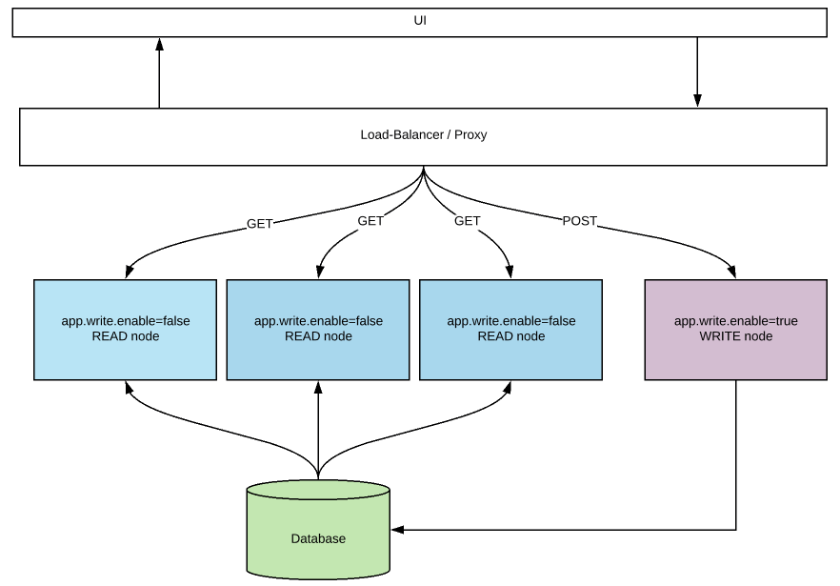
CQRS Pattern With Spring Boot
Notes:
So based on a property, we change if the app is going to behave like a read-only node or write-only node. It gives us the ability to run multiple instances of an app with different modes. I can have 1 instance of my app which does the writing while I can have multiple instances of my app just for serving the read requests. They can be scaled in-out independently. We can place them behind a load balancer / proxy like nginx – so that READ / WRITE requests could be forwarded to appropriate instances using path based routing or some other mechanism.

Slide 36
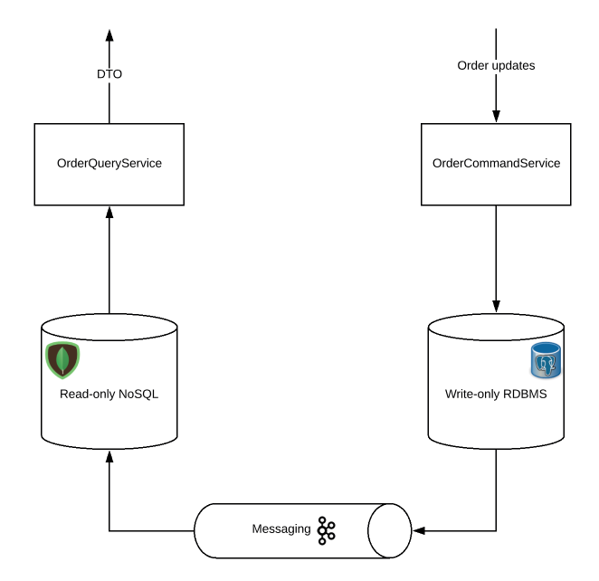
CQRS Pattern With Spring Boot
In the previous slide example we had used the same DB.
We can even go one level further by having separating databases for READ and WRITE as shown here.
That is, any write operations will push the changes to the read database via event sourcing
CQRS Pattern brings additional benefits like using different DBs for the same application with well optimized data schema.
However do note that data will be eventually consistent in this approach! As we can run multiple instances of read nodes with its own DB, we can even place them in different regions to provide user experience with minimal latency.
Notes:
Other than easy maintenance and scaling benefits, CQRS Pattern provides few other benefits like parallel development. That is, 2 different developers/team could work together on a Microservice. When one person could work on Query side while other person can work on the Command side.

Slide 37
Saga Pattern
Problem
When each service has its own database and a business transaction spans multiple services, how do we ensure data consistency across services? For example, for an e-commerce application where customers have a credit limit, the application must ensure that a new order will not exceed the customer’s credit limit. Since Orders and Customers are in different databases, the application cannot simply use a local ACID transaction.
Solution
A Saga represents a high-level business process that consists of several sub requests, which each update data within a single service. Each request has a compensating request that is executed when the request fails. It can be implemented in two ways:
Choreography — When there is no central coordination, each service produces and listens to another service’s events and decides if an action should be taken or not.
Orchestration — An orchestrator (object) takes responsibility for a saga’s decision making and sequencing business logic.

Slide 38
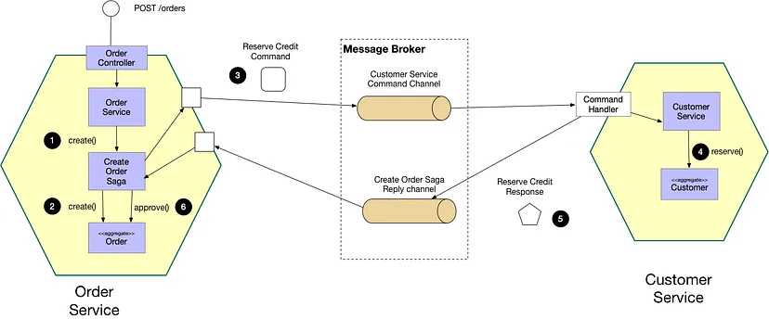
Saga Pattern
Notes:
A microservice is a distributed system made up of numerous smaller services that work together to offer overall application functionality. [1]
Although this architectural style has many advantages, it also has some drawbacks. One of the biggest issues is determining how to manage a transaction that involves numerous services. [1]
While the transaction spans numerous services in a distributed transaction scenario, maintaining ACID (atomicity, consistency, isolation, and durability) is always critical. The second difficulty is controlling the transaction isolation level. It determines the quantity of data visible in a transaction when other services access the same data at the same time.

Slide 39
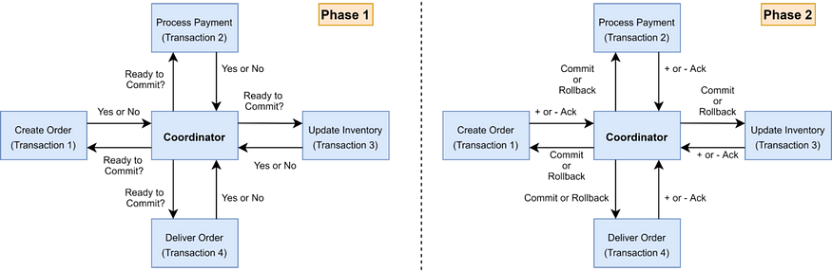
Saga Pattern – 2PC
Two Phase Commiting Protocol (2PC)
2PC is a popular method for implementing distributed transactions.
There is a coordinator component that is in charge of controlling the transaction and containing the transaction logic.
The participating nodes, which perform their local transactions, are the other component.
Notes:
There are two phases. In phase one, the coordinator asks the participating nodes if they are ready to commit the transaction and waits for a yes or no response. If all nodes replied yes in phase 1, the coordinator instructs all nodes to commit; otherwise, the coordinator instructs all nodes to roll back.

Slide 40
Saga Pattern – 2PC
The downsides of 2pc protocols are as follows:
The coordinator is responsible for all services, which might lead to a single point of failure.
Because the controller determines when all services are completed, the entire performance of the operation is bound to the slowest service. [
NoSQL databases do not support 2pc.

Slide 41
Saga Architecture Pattern
This pattern manages transactions through a series of local transactions.
After successfully completing the previous phase, the Saga Pattern triggers the next step with the incoming request.
A Saga participant’s work is represented by a local transaction.
Every operation in the Saga can be reversed by a compensatory transaction.
A compensatory transaction must be reversible and idempotent.

Slide 42
Saga Architecture Pattern
The Saga Execution Coordinator
The Saga Execution Coordinator is the key component in putting a Saga flow into action. It includes a Saga log, which records the sequence of events in a distributed transaction.
In the event of a failure, the SEC component examines the Saga log to determine which components are affected and the order in which compensating transactions should be executed.
If there is a failure in the SEC component, it can read the Saga log when it restarts. It can then determine which transactions were successfully rolled back and which are still pending, and take appropriate action.
The Saga pattern can be implemented in two ways: choreography and orchestration.

Slide 43
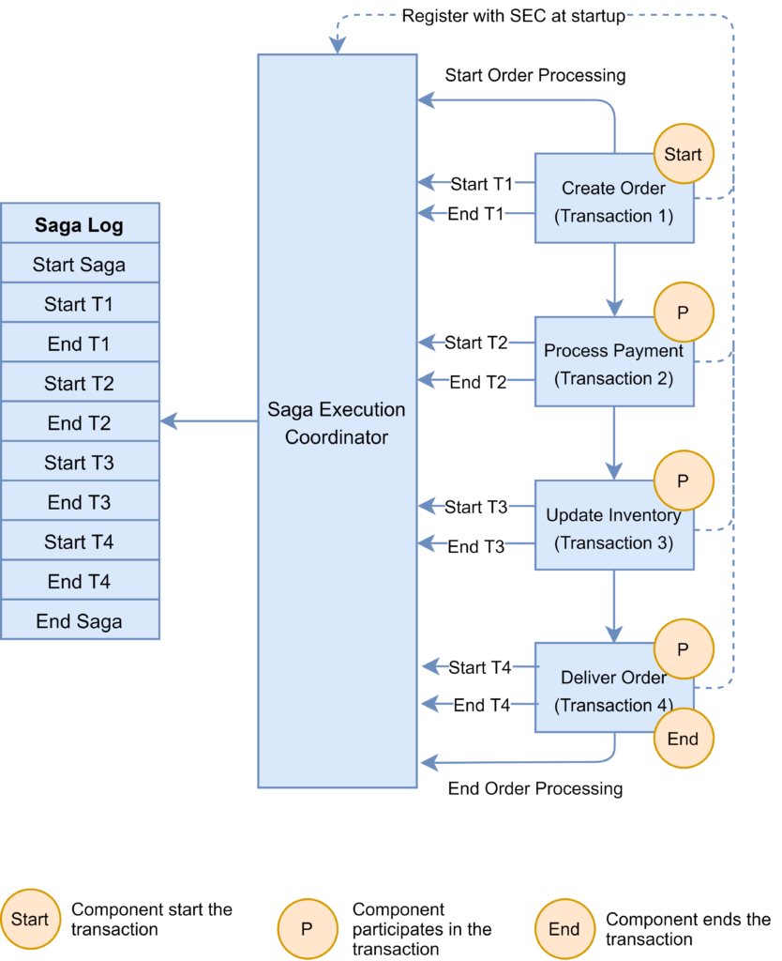
Saga Architecture Pattern
Saga Orchestration Pattern
Microservices are controlled by an orchestrator or conductor.
This allows centralized control of the saga or workflow.
The orchestrator or conductor could be centralized for all the sagas or workflows or could be distributed as individual services for each saga or workflow.
This provides varying levels of independence to each microservice.

Slide 44
Saga Architecture Pattern
Saga Orchestration Pattern’s Benefits
Centralizes the handling of scattered transactions.
Simple to set up and test.
Easy rollback administration.
As new steps are added, the process becomes less complex than the choreographic technique.
We have the ability to manage pending transactions.
Saga Orchestration Pattern’s Drawbacks
The complexity of your infrastructure grows when you manage an additional saga orchestrator service.

Slide 45
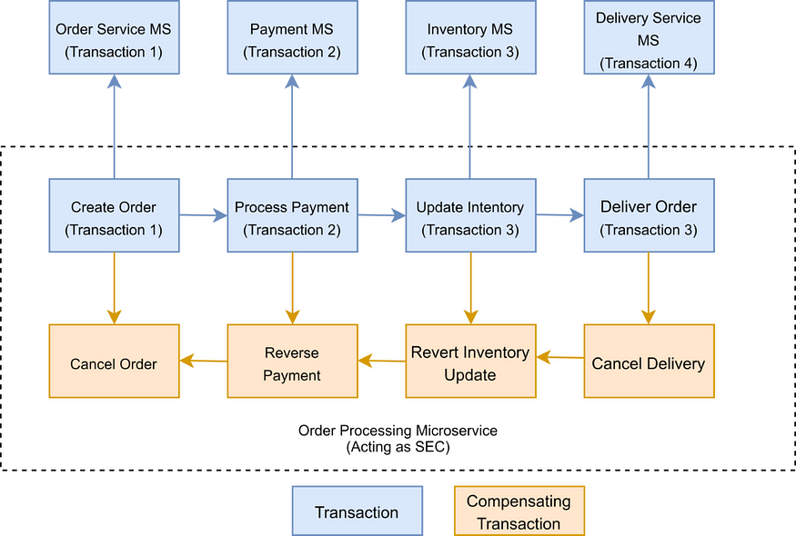
Saga Architecture Pattern
Saga Choreography Pattern
Microservices work independently but coordinate with each other using cues or events.
The method of control of the saga or workflow is determined by a predefined set of cues or events.

Slide 46
Saga Architecture Pattern
Saga Choreography Pattern
Benefits :
Simple to understand and install into an existing system because the services that trigger the event are distinct from each other.
It can be quite useful if your procedure has two to four steps.
Drawbacks :
However, keeping track of which service is listening to which events can grow more complex as the flow becomes more complex.
As services must subscribe to one another, there may be cyclical dependencies.
Testing is tough since all services must be operational in order to thoroughly test the system.
Note: The Axon Saga framework can be used to implement Saga patterns.
The Axon Saga framework is a Spring Boot-based lightweight saga pattern framework.

Slide 47
Saga Architecture Pattern
Which Saga Pattern to use?
System complexity
Coordination requirements
Fault tolerance and scalability
Centralization vs. decentralization trade-offs
Notes:
System complexity: The orchestration pattern is appropriate for systems with complicated business logic, where the control flow must be controlled centrally to maintain consistency and compliance with business requirements. The choreography pattern, on the other hand, is better suited for systems with basic business logic, where services can work independently and interact via event-based communication. [3]
Coordination requirements: The orchestration pattern is beneficial when tight coordination and interaction between services is required, as the orchestrator may handle communication and guarantee that each service completes its duty before moving on to the next. The choreography design, on the other hand, is better suited for loosely connected systems in which each service can work independently and communicate with other services as needed. [3]
Fault tolerance and scalability: Because the central orchestrator can handle errors and retries and improve system flow, the orchestration pattern can be more fault-tolerant and scalable. Choreography patterns, on the other hand, can be more durable and flexible to changes because each service can react to events and update its behavior without relying on a central component. [3]
Centralization vs. decentralization trade-offs: The orchestration pattern centralizes control and decision-making, which simplifies system development and management but introduces a single point of failure and a possible bottleneck. The choreography pattern, on the other hand, distributes power and decision-making, which can boost service autonomy and flexibility while also making the system more complex and difficult to operate. [3]

Slide 48
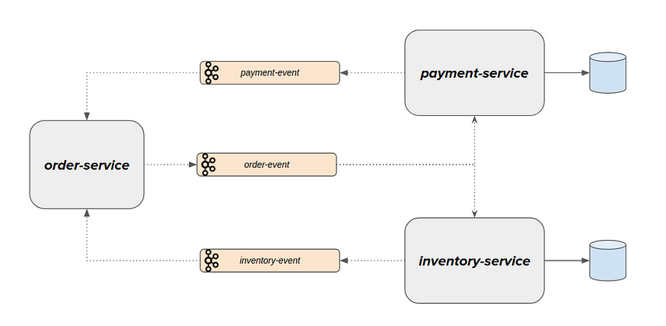
Saga Architecture Pattern
Implementing Choreography-based Saga Pattern in Spring Boot
Event Sourcing
Every change in an application’s state is recorded as an event.
This event is saved in the database/event store (for tracking purposes) and is also broadcast on the event bus for consumption by other parties.
Example
Notes:
A command to make a new order is received by the “order-service”. This request is executed and raised as an event when an order is created. OrderCreated event (used past tense because it has already occurred) simply informs “order-service” that a new order request has been received and is being held in the PENDING/CREATED status and it has not yet been fulfilled.
The payment/inventory service may now be interested in listening to those occurrences and reserving/rejecting payment/inventory. Even these might be considered an event. Payment has been reserved/rejected for the event. Payment reserved/rejected event and Order-service may listen to these events and fulfill/cancel the initial purchase request.

Slide 49
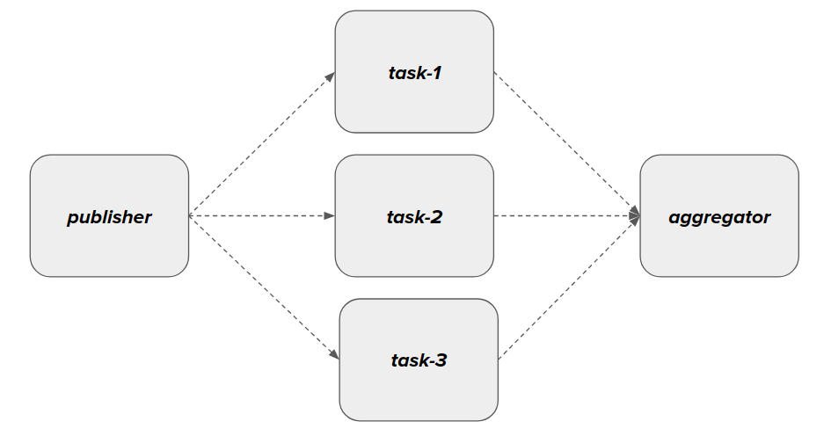
Scatter Gather Pattern
Let’s consider an application in which we need to do a set of tasks to complete the business workflow.
If these tasks do not depend on each other, then it does not make sense to do them sequentially. We can do these tasks in parallel.
Scatter Gather Pattern helps us to distribute these tasks to achieve parallel processing of tasks/messages/events & finally aggregate the responses as a single response as shown above.

Slide 50
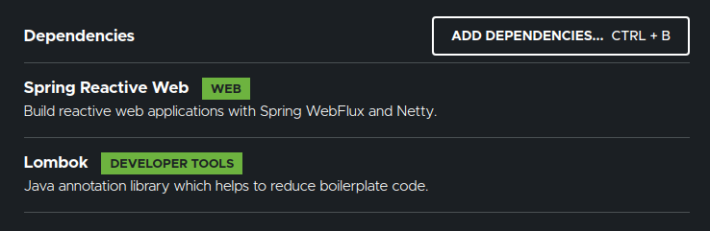

Scatter Gather Pattern
DEMO
NATS Server:
Please ensure that NATS server is up and running. We can easily spin up NATS by using docker.
docker run -p 4222:4222 nats:alpine
Project Setup
Create a Spring Boot application with below dependencies.
It will be a multi-module maven project as shown here.
Our project depends on super-fast NATS messaging server. So add this dependency as well.
<dependency>
<groupId>io.nats</groupId>
<artifactId>jnats</artifactId>
<version>2.6.8</version>
</dependency>

Slide 51
Scatter Gather Pattern
DEMO
Scatter Gather Pattern
Now lets work on the flight-search customer facing app.
NATS bean
Controller
ScatterGatherService
This class is responsible for broadcasting the request and receiving the responses
Airline – Service
This service class represents the individual airlines. It receives the request and provide the schedules along with price.
This is a separate app. We would be running multiple instances of this app.
Common DTO
Flight Search Request
Flight Schedule
Flight Search ResponseAirline – Service

Slide 52
Scatter Gather Pattern
DEMO
I send a request
http://localhost:8080/flight/Houston/LasVegas
I receive a response

Slide 53
Observability Patterns
Log Aggregation
Performance Metrics
Distributed Tracing
Health Check

Slide 54
Log Aggregation
Problem
Consider a use case where an application consists of multiple service instances that are running on multiple machines. Requests often span multiple service instances. Each service instance generates a log file in a standardized format. How can we understand the application behavior through logs for a particular request?
Solution
We need a centralized logging service that aggregates logs from each service instance. Users can search and analyze the logs. They can configure alerts that are triggered when certain messages appear in the logs. For example, PCF does have Loggeregator, which collects logs from each component (router, controller, diego, etc...) of the PCF platform along with applications. AWS Cloud Watch also does the same.

Slide 55
Performance Metrics
Problem
When the service portfolio increases due to microservice architecture, it becomes critical to keep a watch on the transactions so that patterns can be monitored and alerts sent when an issue happens. How should we collect metrics to monitor application perfomance?
Solution
A metrics service is required to gather statistics about individual operations. It should aggregate the metrics of an application service, which provides reporting and alerting. There are two models for aggregating metrics:
Push — the service pushes metrics to the metrics service e.g. NewRelic, AppDynamics
Pull — the metrics services pulls metrics from the service e.g. Prometheus

Slide 56
DEMO
Suppose in project, we've been building three different applications. All three applications are based on Spring Boot but have very different workloads.
They've all reached their way to the production environment and have been running steadily for quite some time now.
We do regular (weekly basis) deployments of our applications to production with bug fixes, new features, and technical improvements.
The organisation has a traditional infrastructure workflow in the sense that deployments to the VM instances on acceptance and production happen via the (remote hosting) provider.
The hosting provider is responsible for the uptime of the applications and therefore they keep an eye on system metrics through the usage of their own monitoring system.
As a team, we are able to look in the system, but it doesn't say much about the internals of our application.
In the past, we've asked to add some additional metrics to their system, but the system isn't that easy to configure with additional metrics.
To us as a team runtime statistics about our applications and the impact our changes have on the overall health are crucial to understanding the impact of our work.

Slide 57
DEMO
Spring Boot Actuator and Micrometer
If we use Spring Boot before we've probably heard of Spring Boot Actuator.
Actuator is a set of features that help you monitor and manage your application when it moves away from your local development environment and onto a test, staging or production environment.
It helps expose operational information about the running application - health, metrics, audit entries, scheduled task, env settings, etc. You can query the information via either several HTTP endpoints or JMX beans.
Being able to view the information is useful, but it's hard to spot trends or see the behaviour over a period of time.
Notes:
In our project, we're using Spring Boot 2 and my team was pretty excited that we were able to start using Micrometer, an instrumentation library powering the delivery of application metrics. Micrometer is the default metrics library in Spring Boot 2 and it doesn't just give you metrics from your Spring application, but can also deliver JVM metrics (garbage collection and memory pools, etc) and also metrics from the application container. Micrometer has several different libraries that can be included to ship metrics to different backends and has support for Prometheus, Netflix Atlas, CloudWatch, Datadog, Graphite, Ganglia, JMX, Influx/Telegraf, New Relic, StatsD, SignalFx, and Wavefront.
Because we didn't have a lot of control over the way our applications were deployed we looked at the several different backends supported by a micrometer. Most of the above backends work by pushing data out to a remote (cloud service). Since the organisation we work for doesn't allow us to push this 'sensitive' data to a remote party we looked at self-hosted solutions. We started with looking into Prometheus (and Grafana) and we soon learned that it was really easy to get a monitoring system up and running within an hour. In the rest of this post, I'll show you how easy it is to start monitoring Spring Boot applications with Prometheus and Grafana.

Slide 58
DEMO
Prometheus
Prometheus is an open-source system monitoring and alerting toolkit originally built at SoundCloud and now part of the Cloud Native Computing Foundation. Some of the features that appealed to us were:
No reliance on distributed storage; single server nodes are autonomous.
Time-series collection happens via a pull model over HTTP.
Targets are discovered via service discovery or static configuration.
Multiple modes of graphing and dashboarding support.
Prometheus uses a file called prometheus.yml as its main configuration file. Within the configuration file, you can specify where it can find the targets it needs to monitor, specify recording rules and alerting rules.
Notes:
The following example shows a configuration with a set of statics targets for test and staging environments. You can decide to monitor all environments within one Prometheus instance, but you could of course also use a separate Prometheus instance for monitoring just the production environment.

Slide 59
DEMO
Prometheus
The following example shows a configuration with a set of statics targets for test and staging environments. You can decide to monitor all environments within one Prometheus instance, but you could of course also use a separate Prometheus instance for monitoring just the production environment.
Look yaml from project repo
As we can see the configuration is pretty simple. We can add specific labels to the targets which can, later on, be used for querying, filtering, and creating a dashboard based upon the information stored within Prometheus. If we want to get started quickly with Prometheus and have Docker on our environment we can use the official docker Prometheus image by running the following command and provide a custom configuration from your host machine by running:
$ docker run -p 9090:9090 -v /tmp/prometheus.yml:/etc/prometheus/prometheus.yml prom/prometheus:v2.24.1
Notes:
The following example shows a configuration with a set of statics targets for test and staging environments. You can decide to monitor all environments within one Prometheus instance, but you could of course also use a separate Prometheus instance for monitoring just the production environment.

Slide 60
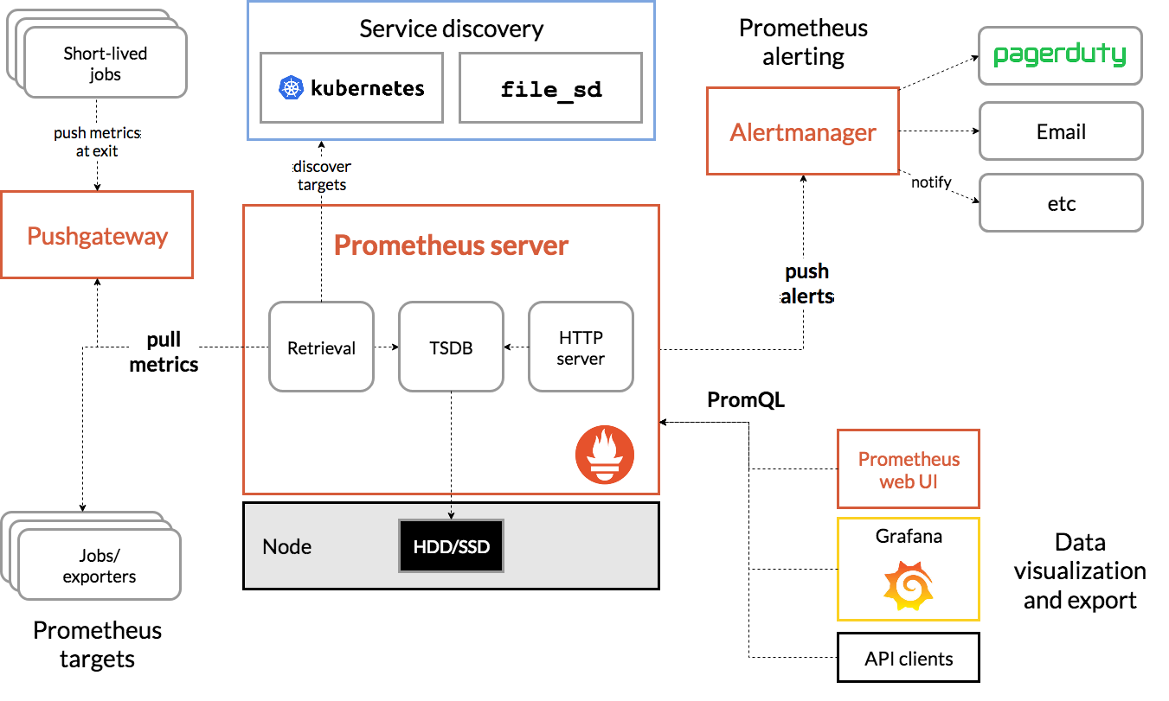
DEMO
Prometheus
In the example, we bind-mount the main Prometheus configuration file from the host system.
To get an overview of the toolset surrounding Prometheus, take a look at the following diagram.

Slide 61
DEMO
Grafana
Grafana allows you to query, visualize, alert on and understand your metrics no matter where they are stored. Create, explore, and share dashboards with your team and foster a data-driven culture.
The cool thing about Grafana is (next to the beautiful UI) that it's not tied to Prometheus as its single data source like for instance Kibana is tied to Elasticsearch. Grafana can have many different data sources like AWS Cloudwatch, Elasticsearch, InfluxDB, Prometheus, etc. This makes it a very good option for creating a monitoring dashboard. Grafana talks to Prometheus by using the PromQL query language.
For Grafana there is also an official Docker image available for you to use. You can get Grafana up and running with a simple command.
$ docker run -p 3000:3000 grafana/grafana:5.4.3
Notes:
Now if we connect Grafana with Prometheus as the data source and install this excellent JVM Micrometer dashboard into Grafana we can instantly start monitoring our Spring Boot application. You will end up with a pretty mature dashboard that lets you switch between different instances of your application.
If you want to start everything all at once you can easily use docker-compose.

Slide 62
Distributed Tracing
Problem
In microservice architecture, requests often span multiple services. Each service handles a request by performing one or more operations across multiple services. Then, how do we trace a request end-to-end to troubleshoot the problem?
Solution
We need a service which
Assigns each external request a unique external request id.
Passes the external request id to all services.
Includes the external request id in all log messages.
Records information (e.g. start time, end time) about the requests and operations performed when handling an external request in a centralized service.
Spring Cloud Slueth, along with Zipkin server, is a common implementation.

Slide 63
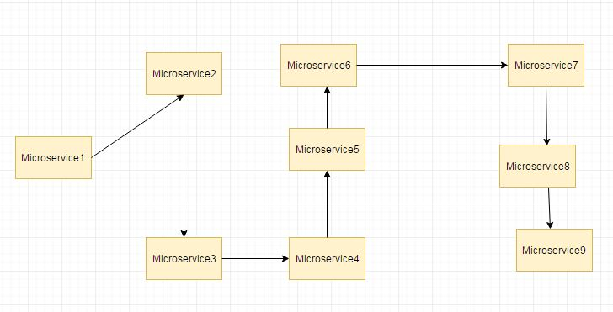
Distributed Log Tracing using Sleuth and Zipkin Example
Microservices architecture involve multiple services which interact with each other. So a functionality may involve call to multiple microservices. Usually for systems developed using Microservices architecture, there are many microservices involved. These microservices collaborate with each other.
Consider the following microservices-

Slide 64
Distributed Log Tracing using Sleuth and Zipkin Example
If suppose during such calls there are some issues like exception has occurred. Or may be there are latency issues due to a particular service taking more than expected time.
How do we identify where the issue is occurring. In regular project we would have used logging to analyze the logs to know more about occurred exceptions and also performance timing.
But since microservices involves multiple services we cannot use regular logging. Each Service will be having its own separate logs. So we will need to go through the logs of each service. Also how do we correlate the logs to a request call chain i.e which logs of microservices are related to Request1, which are related to Request2. To resolve these issues we make use of Spring Cloud Sleuth and Zipkin
Spring Cloud Sleuth is used to generate and attach the trace id, span id to the logs so that these can then be used by tools like Zipkin and ELK for storage and analysis
Zipkin is a distributed tracing system. It helps gather timing data needed to troubleshoot latency problems in service architectures. Features include both the collection and lookup of this data

Slide 65
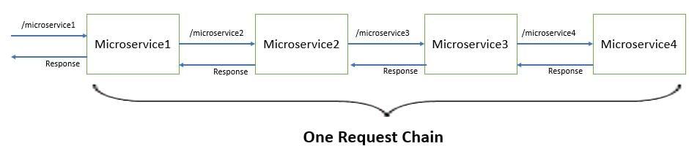
Distributed Log Tracing using Sleuth and Zipkin Example
Lets Begin-
We will be dividing this demo into 3 parts-
Develop four Spring Boot Microservices modules which interact with each other.
Implement distributed tracing using Spring Cloud Sleuth
View distributed tracing using Zipkin
Develop four Spring Boot Microservices modules which interact with each other
We will be developing the spring boot microservices as follows-

Slide 66
Health Check
Problem
When microservice architecture has been implemented, there is a chance that a service might be up but not able to handle transactions. In that case, how do you ensure a request doesn't go to those failed instances? With a load balancing pattern implementation.
Solution
Each service needs to have an endpoint which can be used to check the health of the application, such as /health. This API should o check the status of the host, the connection to other services/infrastructure, and any specific logic.
Spring Boot Actuator does implement a /health endpoint and the implementation can be customized, as well.

Slide 67
Cross-Cutting Concern Patterns
External Configuration
Service Discovery Pattern
Circuit Breaker Pattern
Blue-Green Deployment Pattern

Slide 68
External Configuration
Problem
A service typically calls other services and databases as well. For each environment like dev, QA, UAT, prod, the endpoint URL or some configuration properties might be different. A change in any of those properties might require a re-build and re-deploy of the service. How do we avoid code modification for configuration changes?
Solution
Externalize all the configuration, including endpoint URLs and credentials. The application should load them either at startup or on the fly.
Spring Cloud config server provides the option to externalize the properties to GitHub and load them as environment properties. These can be accessed by the application on startup or can be refreshed without a server restart.

Slide 69
Service Discovery Pattern
Problem
When microservices come into the picture, we need to address a few issues in terms of calling services:
With container technology, IP addresses are dynamically allocated to the service instances. Every time the address changes, a consumer service can break and need manual changes.
Each service URL has to be remembered by the consumer and become tightly coupled.
So how does the consumer or router know all the available service instances and locations?
Solution
A service registry needs to be created which will keep the metadata of each producer service. A service instance should register to the registry when starting and should de-register when shutting down. The consumer or router should query the registry and find out the location of the service. The registry also needs to do a health check of the producer service to ensure that only working instances of the services are available to be consumed through it. There are two types of service discovery: client-side and server-side. An example of client-side discovery is Netflix Eureka and an example of server-side discovery is AWS ALB.

Slide 70
Circuit Breaker Pattern
Problem
A service generally calls other services to retrieve data, and there is the chance that the downstream service may be down. There are two problems with this: first, the request will keep going to the down service, exhausting network resources and slowing performance. Second, the user experience will be bad and unpredictable. How do we avoid cascading service failures and handle failures gracefully?
Solution
The consumer should invoke a remote service via a proxy that behaves in a similar fashion to an electrical circuit breaker. When the number of consecutive failures crosses a threshold, the circuit breaker trips, and for the duration of a timeout period, all attempts to invoke the remote service will fail immediately. After the timeout expires the circuit breaker allows a limited number of test requests to pass through. If those requests succeed, the circuit breaker resumes normal operation. Otherwise, if there is a failure, the timeout period begins again.
Netflix Hystrix is a good implementation of the circuit breaker pattern. It also helps you to define a fallback mechanism which can be used when the circuit breaker trips. That provides a better user experience.

Slide 71
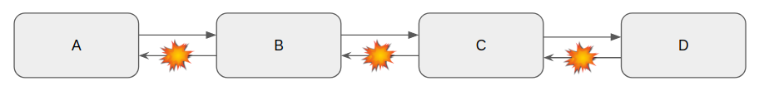
Circuit Breaker Pattern
Circuit Breaker Pattern, one of the Microservice Design Patterns for designing highly resilient Microservices using a library called resilience4j along with Spring Boot.
Need For Resiliency
Microservices are distributed in nature. When you work with distributed systems, always remember this number one rule – anything could happen. We might be dealing with network issues, service unavailability, application slowness etc. An issue with one system might affect another system behavior/performance. Dealing with any such unexpected failures/network issues could be difficult to solve.
Ability of the system to recover from such failures and remain functional makes the system more resilient. It also avoids any cascading failures to the downstream services.
Circuit Breaker Pattern
In Microservice architecture, when there are multiple services (A, B, C & D), one service (A) might depend on the other service (B) which in turn might depend on C and so on. Sometimes due to some issue, Service D might not respond as expected. Service D might have thrown some exception like OutOfMemory Error or Internal Server Error. Such exceptions are cascaded to the downstream services which might result in poor user experience as shown below.
We have Retry Pattern in which we could retry couple of times until we get the proper response. The problem with this retry approach is – if it was an intermittent network issue, then it makes sense in retrying! What if it was an app issue?

Slide 72
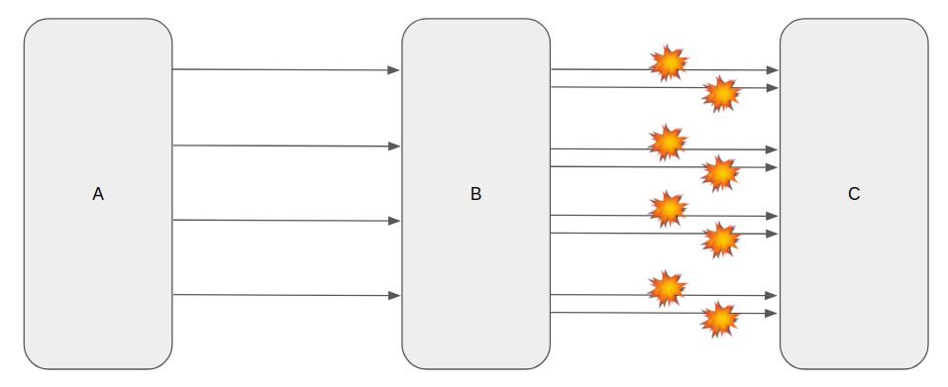
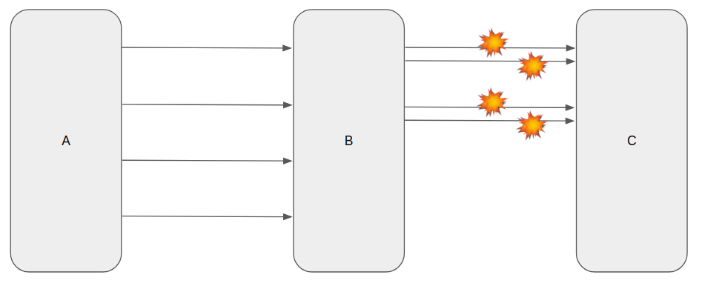
Circuit Breaker Pattern
Let’s consider below architecture in which Service B depends on Service C which has an issue. It is not behaving correctly. With this Retry Pattern, Service B will be sending multiple requests again and again to Service C assuming it will work. When there are hundreds of concurrent requests are sent to Service B which in turn would be bombarding Service C with Retry requests!
This is where Circuit Breaker Pattern helps us! When the requests to Service B are continuously failing, what is the point for sending the requests to Service C? Circuit Breaker simply skips the calls to Service C and goes with the fall back method / default values instead for certain duration which is configurable. That is, it does not bombard Service C continuously. It gives Service C sometime to recover from failure. Circuit Breaker Pattern retries after some time and so on.

Slide 73
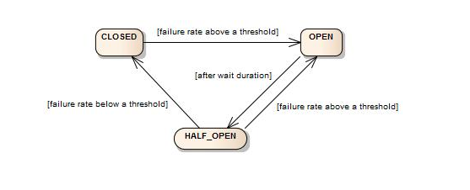
Circuit Breaker Pattern – State
Circuit Breaker maintains some states and its behavior would change depends on the state.
State | Description
CLOSED | Dependent service (Service C) is up. Requests for Service C is allowed.
OPEN | Dependent service is unavailable / Error rate is beyond threshold. Requests for Service C is skipped
HALF_OPEN | Once the state becomes OPEN, We do wait for sometime in the OPEN state. After certain duration, the state becomes HALF_OPEN. During this period, we do send some requests to Service C to check if we still get the proper response. If the failure rate is below the threshold, the state would become CLOSED. If the failure rate is above the threshold, then the state becomes OPEN once again. This cycle continues.

Slide 74
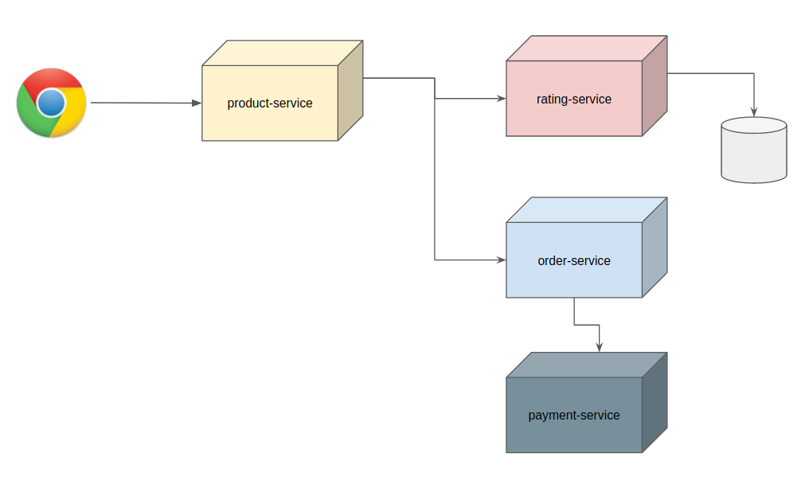
Circuit Breaker Pattern- Sample Application
Let’s consider this simple application to explain this Circuit Breaker Pattern.
We have multiple Microservices as shown above
Product service acts as product catalog and responsible for providing product information
Product service depends on the rating service.
Rating service maintains product reviews and ratings. It is notorious for being slow and throwing random errors.
Whenever we look at the product details, product service sends the request to the rating service to get the reviews for the product.
We have other services like account-service, order-service and payment-service etc which is not relevant to this article discussion.
Product service is a core service without which the user can not start the order workflow.
Notes:
Product Service
Product service is responsible for providing list of products based on the user search criteria. It is one of the core services which should be up & responsive even under critical load. If it is down, it will have a severe impact on the revenue. Since this service depends on rating-service, we do not want any network issues or rating-service unavailability affect this product-service. This is where resilience4j library comes into picture.
Configuration
I first create a configuration for resilience4j as shown below.
We can have multiple service configuration as shown below.
I use the COUNT_BASED sliding window in which we track the given number of requests.
failureRateThreshold: I also set the failure threshold as 60 which means if the 60 requests are failing in the 100 requests, keep the circuit breaker in CLOSED state.
waitDurationInOpenState: When the Circuit breaker is in OPEN state, wait for 10 seconds before sending any more requests to rating service.
You can have default configuration and use that for all the services, override values for specific services as shown below.
This product-service acts as a client for the rating-service.
@CircuitBreaker indicates that resilience4j will apply circuit breaker logic for this method execution.
name=ratingService indicates that resilience4j will use the configuration for ratingService in the yaml.
fallbackMethod is used when the main method fails for some reason

Slide 75
Blue-Green Deployment Pattern
Problem
With microservice architecture, one application can have many microservices. If we stop all the services then deploy an enhanced version, the downtime will be huge and can impact the business. Also, the rollback will be a nightmare. How do we avoid or reduce downtime of the services during deployment?
Solution
The blue-green deployment strategy can be implemented to reduce or remove downtime. It achieves this by running two identical production environments, Blue and Green. Let's assume Green is the existing live instance and Blue is the new version of the application. At any time, only one of the environments is live, with the live environment serving all production traffic. All cloud platforms provide options for implementing a blue-green deployment.
There are many other patterns used with microservice architecture, like Sidecar, Chained Microservice, Branch Microservice, Event Sourcing Pattern, Continuous Delivery Patterns, and more. The list keeps growing as we get more experience with microservices. I am stopping now to hear back from you on what microservice patterns you are using.

